Slide 1

SEVEN DAYS
Days of the Week
A short walk from Monday to Sunday.
Jacob Skogström
jacob.skogstrom@qvantum.com

Slide 2
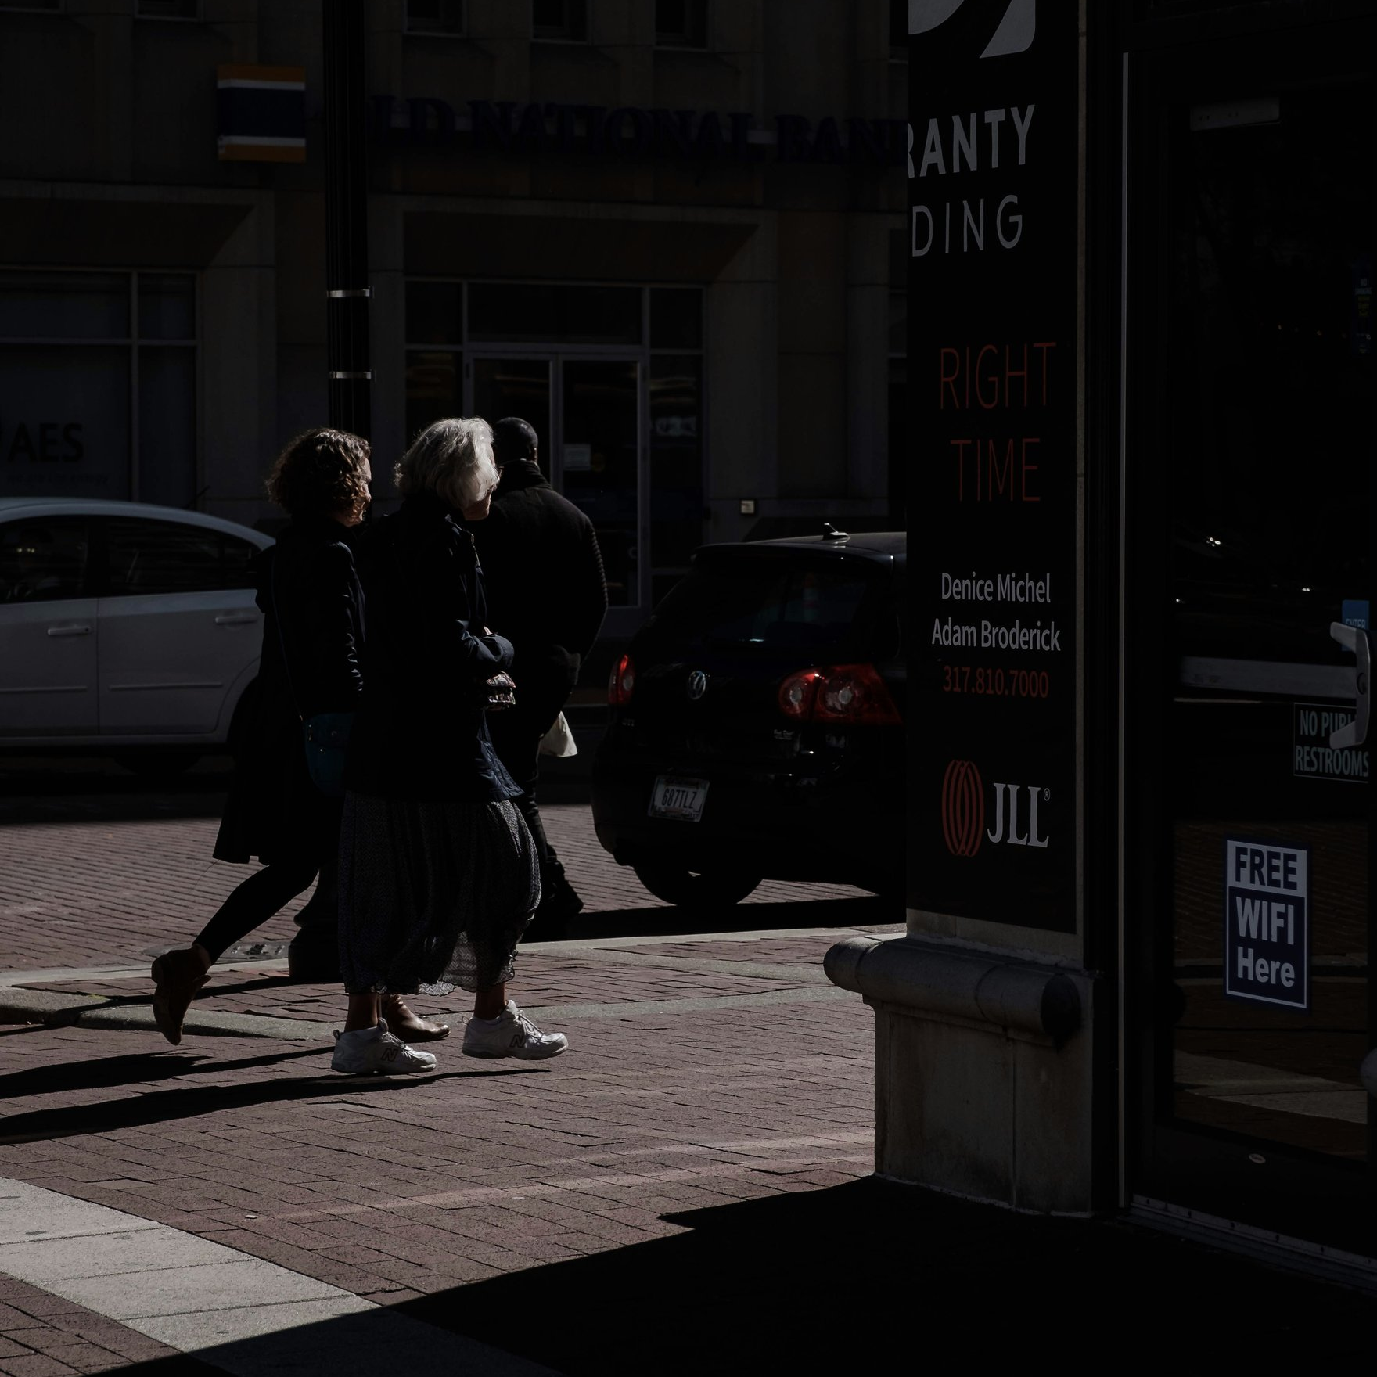
Monday
01 / 07
A fresh start. The week opens with quiet energy — clear the desk, set the intention, and take the first small step forward.

Slide 3
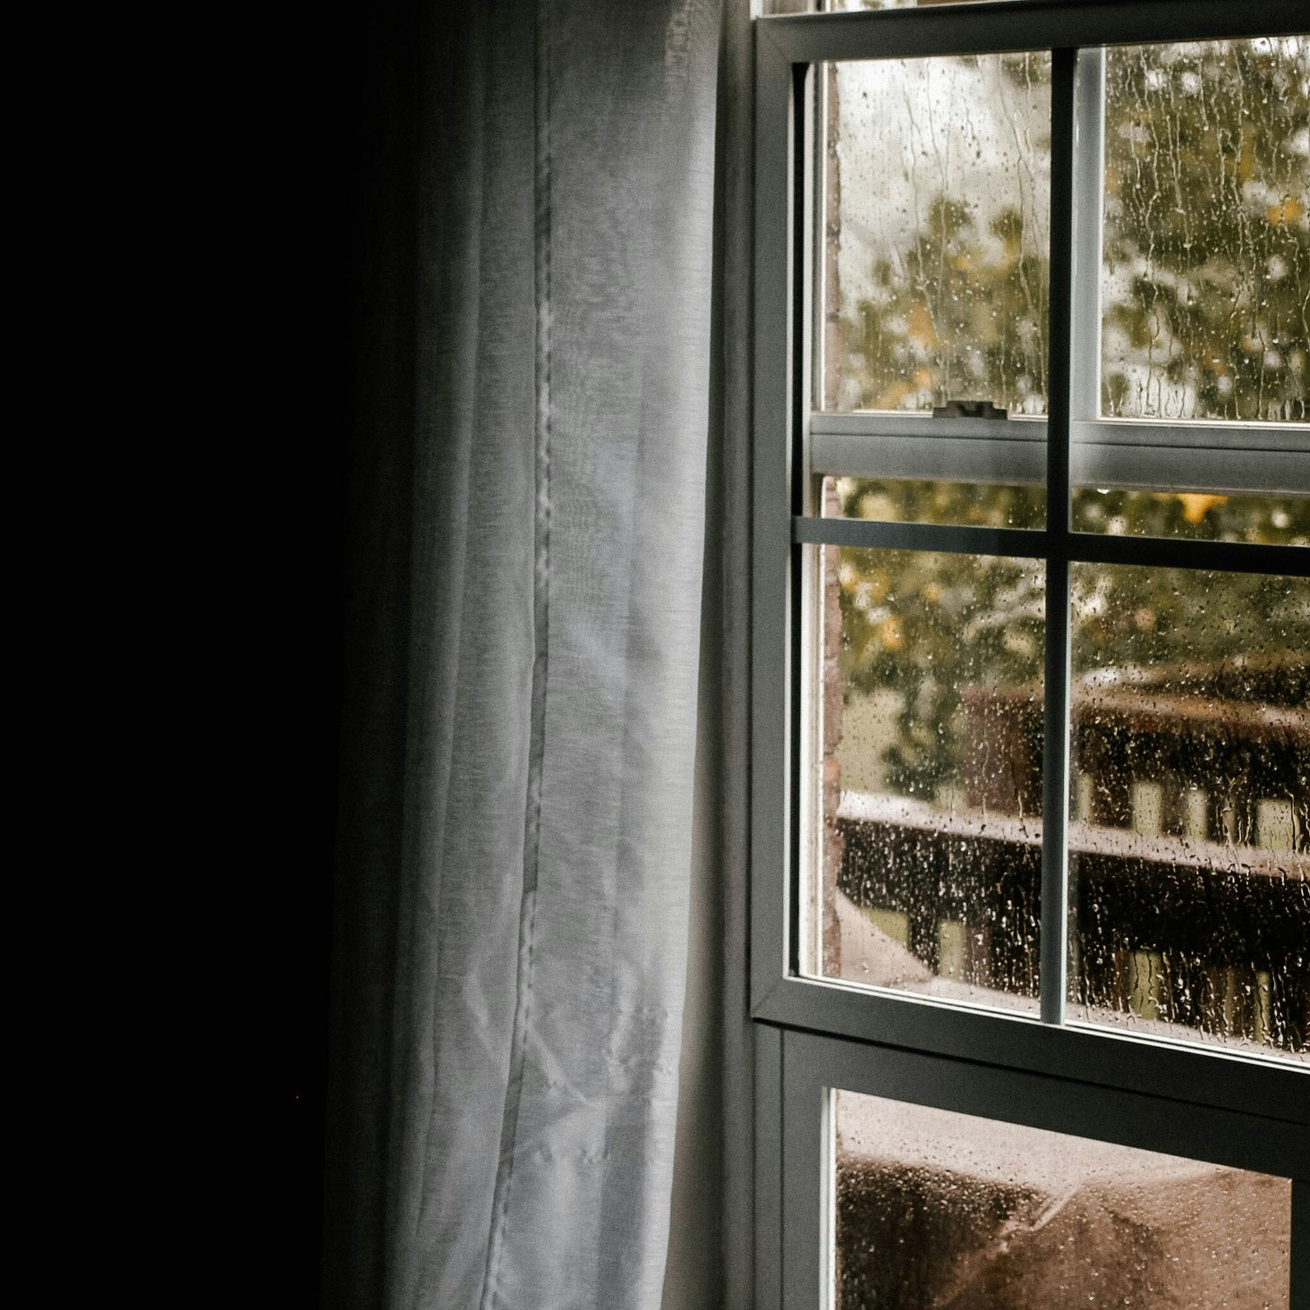
Tuesday
02 / 07
Into the rhythm. Heads down and momentum building — Tuesday is where the real work of the week quietly gets done.

Slide 4

Wednesday
03 / 07
The midpoint. Look up and take stock — Wednesday balances the week between where you started and where you are headed.

Slide 5

Thursday
04 / 07
Almost there. Energy returns as the finish line appears — Thursday is for tying off loose ends and planning the landing.

Slide 6

Friday
05 / 07
Wind down. Ship the last thing, share the wins, and let the week ease toward rest — Friday earns the weekend.

Slide 7

Saturday
06 / 07
Time for yourself. No agenda, just space — Saturday is for home, daylight, and the people and places you love most.

Slide 8

Sunday
07 / 07
Pause and reset. A slow morning and long light — Sunday gathers the week behind you and quietly prepares the one ahead.

